Slide 1
MANUAL ROBOT MODULE-II
ANKIT PURI & ABHISHEK SUKHWAL
THE LNMIIT

Slide 2
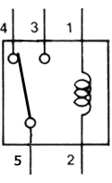
RELAY PIN CONFIGERATION AND INTERNAL STRUCTURE
Normally Open
Normally Closed
NC
NO
B
Input From remote
NO
NC
B
O/P
A
O/P
A
Output to motors
Ground

Slide 3
RELAY PIN CONFIGERATION
5 PIN RELAY
12V
0V
NO
NC
SPOT INDICATES B PIN
B
O/P
A
F
L
0V
B
R
MOTORS

Slide 4
PROCESSING UNIT
+12
0
NO
NC
NO
NC
NO
NC
NO
NC
LF
LB
RF
RB
B
O/P
A
B
O/P
A
B
O/P
A
B
O/P
A
0
0
0
0
+
LM-A
-
+
RM-A
-
+
LM-B
-
+
RM-B
-

Slide 5
FORWARD
+12
0
NO
NC
NO
NC
NO
NC
NO
NC
LF
LB
RF
RB
B
O/P
A
B
O/P
A
B
O/P
A
B
O/P
A
0
0
0
0
B1
B3
+
LM-A
-
+
RM-A
-
F
L
B
R
+
LM-B
-
+
RM-B
-

Slide 6
BACKWARD
+12
0
NO
NC
NO
NC
NO
NC
NO
NC
LF
LB
RF
RB
B
O/P
A
B
O/P
A
B
O/P
A
B
O/P
A
0
0
0
0
B2
B4
+
LM-A
-
+
RM-A
-
F
L
B
R
+
LM-B
-
+
RM-B
-

Slide 7
LEFT
+12
0
NO
NC
NO
NC
NO
NC
NO
NC
LF
LB
RF
RB
B
O/P
A
B
O/P
A
B
O/P
A
B
O/P
A
0
0
0
0
B2
B3
+
LM-A
-
+
RM-A
-
F
L
B
R
+
LM-B
-
+
RM-B
-

Slide 8
RIGHT
+12
0
NO
NC
NO
NC
NO
NC
NO
NC
LF
LB
RF
RB
B
O/P
A
B
O/P
A
B
O/P
A
B
O/P
A
0
0
0
0
B1
B4
+
LM-A
-
+
RM-A
-
F
L
B
R
+
LM-B
-
+
RM-B
-

Slide 9
RELAY CONNECTIONS
FORWARD : B1 , B3
BACKWARD: B2 , B4
LEFT : B2 , B3
RIGHT : B1 , B4

Slide 10
DPDT SWITCHES
S1
S2
P2
P1
S3
S4

Slide 11
DPDT SWITCHES
S1
S2
P2
P1
S3
S4

Slide 12
DPDT SWITCHES
S1
S2
P2
P1
S3
S4

Slide 13
GIVE BOTH THE POLES +12V
S1
S2
+12
+12
S3
S4

Slide 14
DPDT SWITCHES
S1
S2
+12
+12
S3
S4

Slide 15
DPDT SWITCHES
S1
S2
+12
+12
S3
S4

Slide 16
FORWARD
B1
B3
+12
+12
S3
S4

Slide 17
BACKWARD
B1
B3
+12
+12
B2
B4

Slide 18
LEFT
B2
B3
+12
+12
S3
S4

Slide 19
RIGHT
B2
B3
+12
+12
B1
B4

Slide 20
FORWARD
+12
0
NO
NC
NO
NC
NO
NC
NO
NC
LF
LB
RF
RB
B
O/P
A
B
O/P
A
B
O/P
A
B
O/P
A
+12
0
0
0
0
B1
B3
+12
+
LM-A
-
+
RM-A
-
F
L
B
R
+
LM-B
-
+
RM-B
-

Slide 21
BACKWARD
+12
0
NO
NC
NO
NC
NO
NC
NO
NC
LF
LB
RF
RB
B
O/P
A
B
O/P
A
B
O/P
A
B
O/P
A
0
0
0
0
+12
+12
B2
B4
+
LM-A
-
+
RM-A
-
F
L
B
R
+
LM-B
-
+
RM-B
-

Slide 22
LEFT
+12
0
NO
NC
NO
NC
NO
NC
NO
NC
LF
LB
RF
RB
B
O/P
A
B
O/P
A
B
O/P
A
B
O/P
A
0
0
0
0
+12
+12
B2
B3
+
LM-A
-
+
RM-A
-
F
L
B
R
+
LM-B
-
+
RM-B
-

Slide 23
RIGHT
+12
0
NO
NC
NO
NC
NO
NC
NO
NC
LF
LB
RF
RB
B
O/P
A
B
O/P
A
B
O/P
A
B
O/P
A
+12
0
0
0
0
+12
B1
B4
+
LM-A
-
+
RM-A
-
F
L
B
R
+
LM-B
-
+
RM-B
-

Slide 24
Parts List
Metal Chassis
4 Geared DC Motor 12V
4 Tyres
6m CAT 5E LAN Wire Without Connectors(Will be used as Bus Wire)
Remote Box
4 DPDT Switches
6 Relays
2 Zero PCB
12V 1.2Ah Sealed Lead Acid Battery

Slide 25
2 Battery Clips
Soldering Iron (Do not buy cheap ones Soldron 25Watts soldering iron is recommended)
Soldering Wire
Soldering Paste
Soldering Iron Stand(Not Compulsory)
1 Feviquick
Screwdriver Set

Slide 26
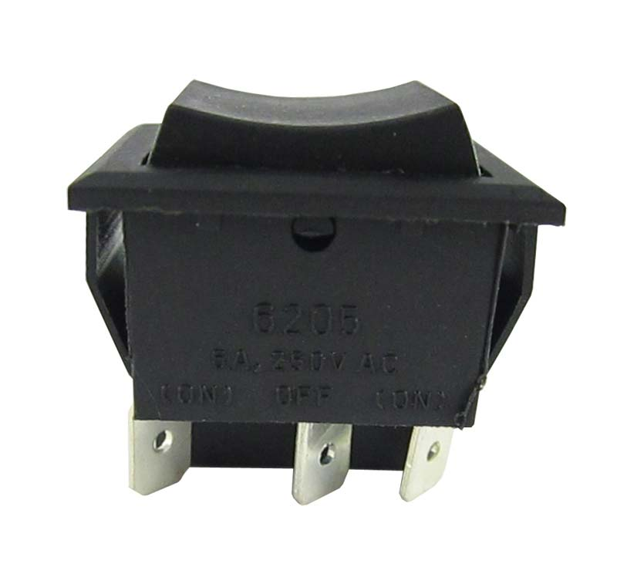
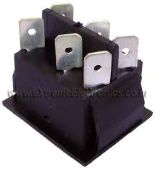
DPDT Switch

Slide 27
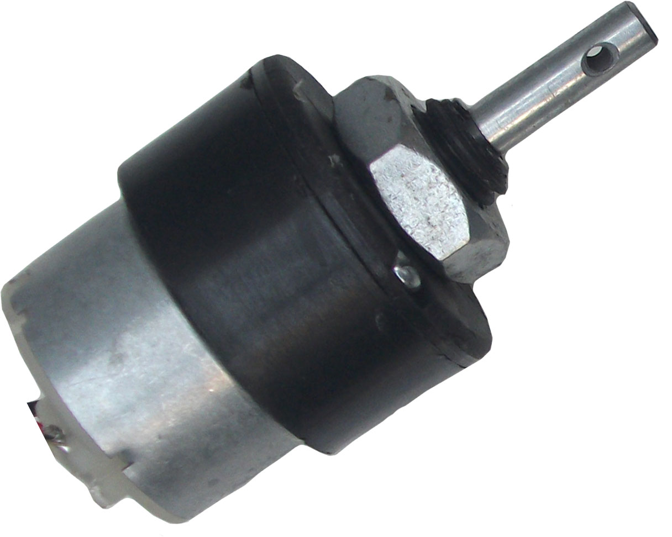
Geared DC Motor

Slide 28
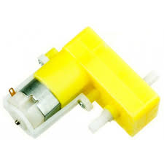
DO NOT BUY THIS MOTOR

Slide 29
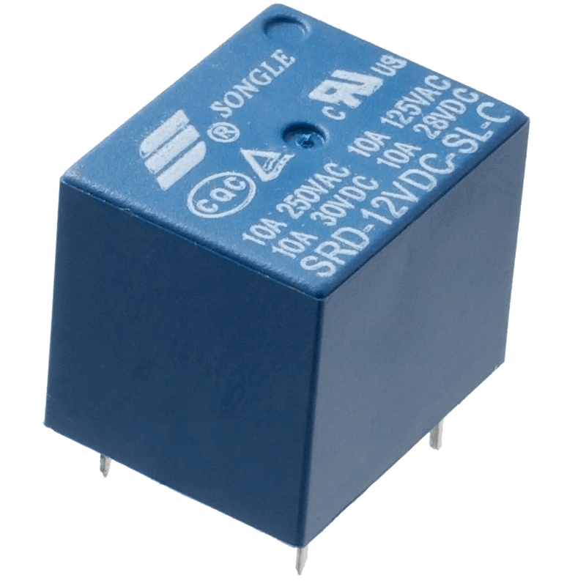
12V Relay

Slide 30


Soldering Iron with Stand

Slide 31
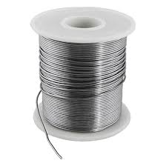

Soldering Flux
Soldering Wire

Slide 32
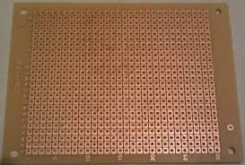
Zero PCB

Slide 33
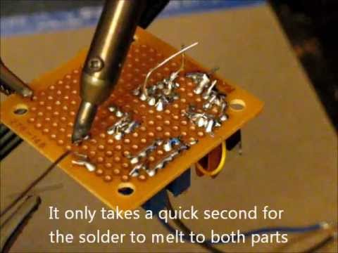

Slide 34


Slide 35
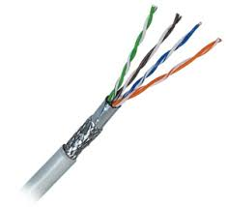
CAT 5E LAN Cable Without Connector

Slide 36

12V Sealed Lead Acid Battery

Slide 37

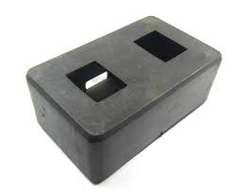
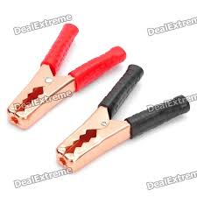
Remote Box and Battery Clips

Slide 38
THANKYOU

